Slide 1

Entity-Attribute Value Model
Aditya Londhe

Slide 2
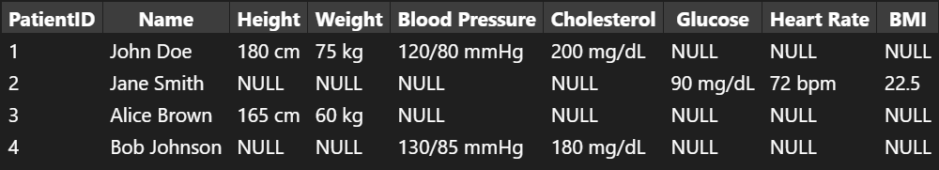
Problem in traditional relational database models
Patients Table (with multiple null values as the data for each attributes is not recorded for every patient).
This leads to wastage of memory.
Also, the number of columns increases as the number of attributes increases.

Slide 3
E-A-V Model
The Entity-Attribute-Value (EAV) model is a data model optimized for the space-efficient storage of sparse or ad-hoc data values.
It's particularly useful in scenarios where the attributes of entities are highly variable and not known in advance
It stores the data in a Triplet format (Entity-Attribute-Value) ,allowing for custom attributes and only non-empty values are stored.

Slide 4
Data Structure
In E-A-V the data is recorded as 3 columns:
Entity: The item which is being described or ID. For example, a patient in a medical database or patientID.
Attribute: A 'property' or 'characteristic' of the entity. For example, height, weight, or blood pressure.
Value: The actual data for the attribute. For example, 180 cm for height, 75 kg for weight.

Slide 5
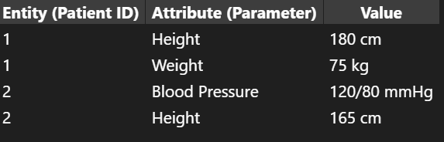
Example Table

Slide 6
Advantages
Disadvantages
Flexibility: Easily add new attributes without changing the schema.
Space Efficiency: Only non-null values are stored, saving space.
Solve Scalability issues. As in relational model the number of Columns increases as the number of attributes
Complex Queries: Queries can become complex and less efficient.
Data Integrity: Ensuring data integrity and validation can be challenging.

Slide 7
Given Problem Table with multiple null values

Slide 8
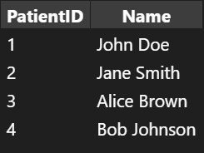
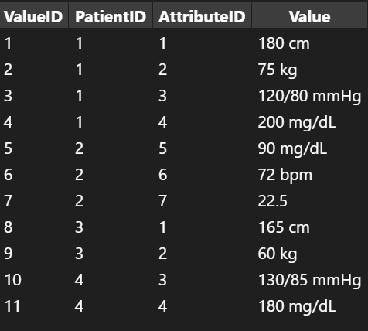
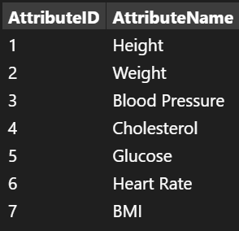
EAV Model Solution
EAV Table
(Entity)
(Attribute)
(Value)
Attribute Table
Patient Table

Slide 9
Thank You

